Slide 1
AI Education and role of the community
Kshitiz Rimal, Developer Sessions

Slide 2
Kshitiz Rimal
Intel AI Student Ambassador
Lead Instructor at Developer Sessions
AI/Deep learning Developer
Full Stack Developer
UI/UX Designer
Twitter: @kshitizrimal
Facebook: fb.me/kshitizrimal

Slide 3
Developer Sessions
What, why and How ?
Our vision

Slide 4
What is Developer Sessions
It’s a community of AI enthusiasts, developers and researchers
Students, Developers, Researchers etc
We have a facebook group as our networking medium
Facebook.com/groups/developersessions

Slide 5
Why?
Started as a personal Necessity
When I was learning AI online, there were no support groups and community to seek help from
When I finished some of the courses and began experimenting with Deep Learning and AI, I saw many people struggling with the same problem that I had when I was starting

Slide 6
What we do?
We are primarily focused on education and Hands on Training
Our goal is to train and facilitate AI enthusiasts and make them able to create something that can be useful to the community
We are more passionate about community projects using AI
Our goal is to teach students, developers and Enthusiasts about AI in a implementation way.

Slide 7
What we did so far
2 Meetups events: July 7 & Oct 14, 2017
2 Workshops: August 4/5 & November 26, 2017
1 Public Project

Slide 8
Nature of Workshop events
Generally 1-2 days long full event workshops
Focused on just enough theory to get started and more emphasis on code and implementation of those theory
To bridge the Gap between International courses on AI and current state of knowledge of AI enthusiasts in Nepal
Project Oriented
At the end, participants will learn to implement something from scratch

Slide 9
Public Project
Cash Recognition for Visually Impaired
Everything is open source
Open to collaboration and contribution
Goal is to implement something that is useful to the society and make the enthusiasts learn something while contributing to the project

Slide 10
What we are trying to do?
Facilitate AI enthusiasts by providing:
Learning resources
Hand on training
Required hardware access
Mentorship from AI experts

Slide 11
Official Support from

Slide 12
Facilities by Intel
Cloud and Cluster Access
Intel DevCloud Access to Academic Projects
Hardware Access
Movidius Neural Compute Stick, Intel Xeon Processors
Learning Resources
Deep Learning and Machine Learning hands on courses
AI Expert Mentorship
Intel DevMesh Open Platform
On Demand Access to AI Experts opinions and mentorship

Slide 13
Our Vision
To connect with every IT/Engineering college in Nepal and facilitate learning environment to AI enthusiasts
We believe if a person is trained and become capable in AI,
He/She can create creative solutions to the problems in his/her local environment.
AI will be used where there is scarcity of domain experts.
DS will be a platform to connect all AI enthusiasts from all over Nepal

Slide 14
Our Vision
Idea and Resource sharing between various Colleges and AI Learners and work collectively as a big community.
Networking via DS events and workshops
Our ultimate goal is to create a vibrant community of AI learners and Facilitate them to solve the problems they are interested in
With this approach there will be idea sharing networking and easy identification of solution to the problems

Slide 15
Our Vision
Ultimately leading to a situation where AI enthusiasts can build something for the society they live in and contribute to it using Artificial Intelligence.
While contributing they will learn and gain proper experience ultimately making them better in their career as AI researcher or developer.
Artificial Intelligence has the power to make difference where other technologies failed to perform.
From Medicine to Agriculture it can be implemented to automate any task with human level intellect.

Slide 16
Our Vision
With the help of Intel and all the willing companies and organizations and this platform we are trying to create
We can connect with Experts from Nepal as well as out of Nepal and discuss ideas and seek help from.
With this approach we can finally facilitate AI learners from all over Nepal
They will contribute to the society using Open Projects which uses Artificial Intelligence.
Together we can create this community and solve local problems using Artificial Intelligence.

Slide 17
Some resources

Slide 18
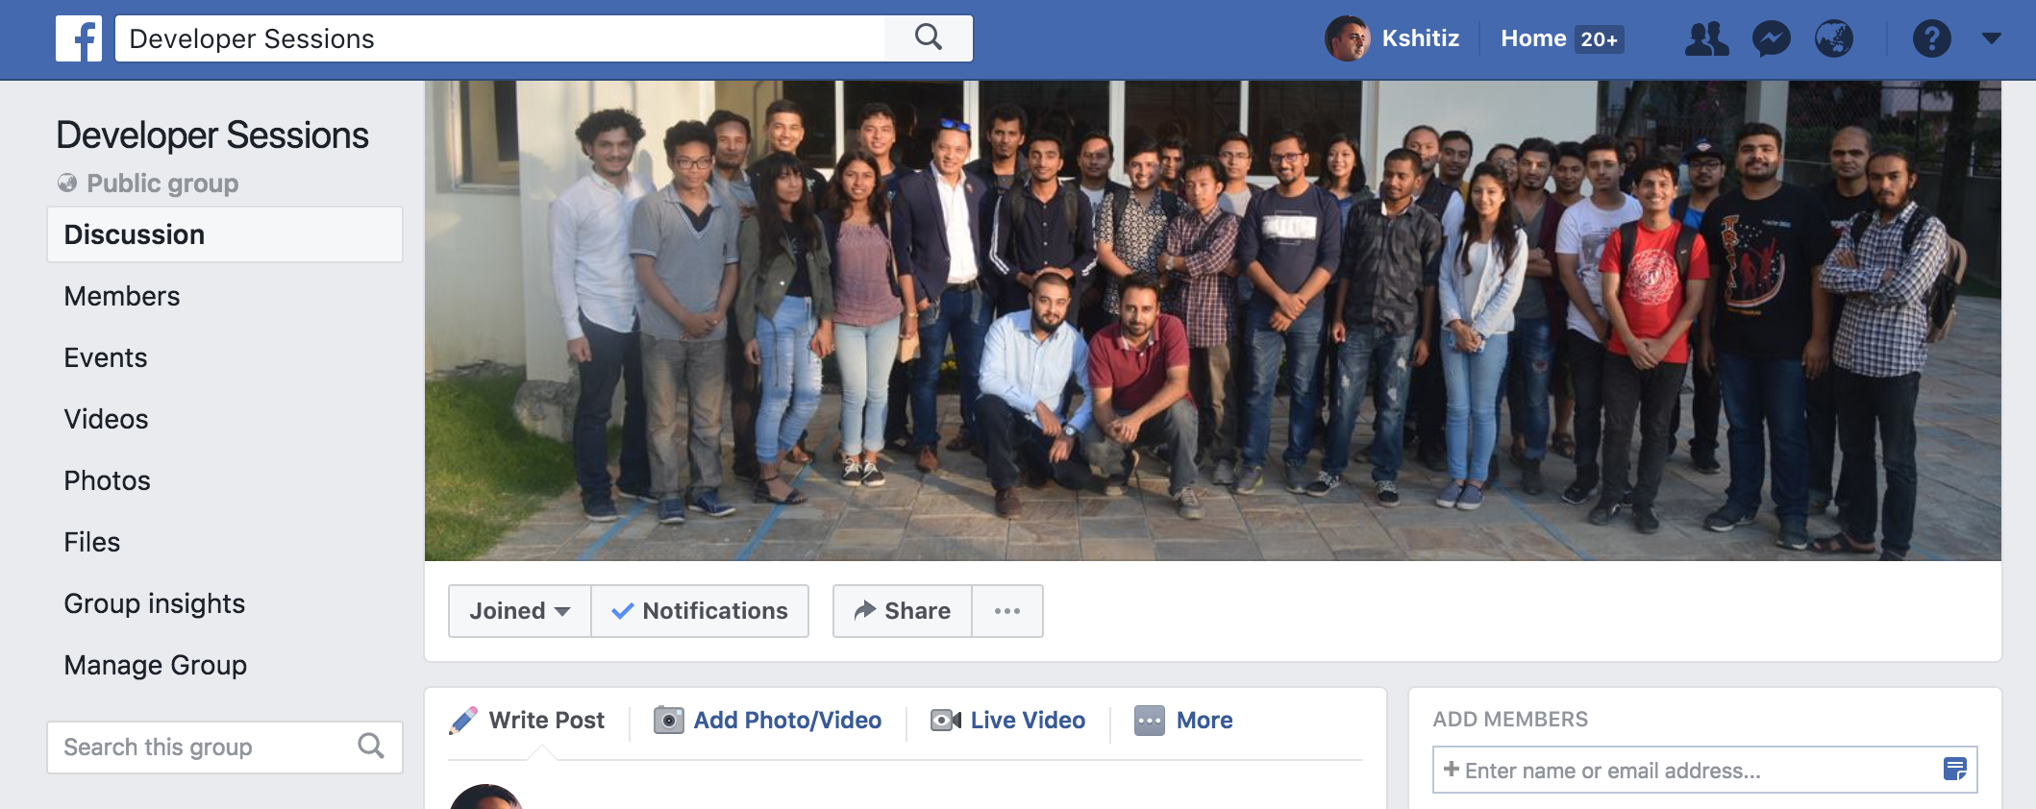
Our Group: Developer Sessions facebook.com/groups/developersessions

Slide 19
devmesh.intel.com

Slide 20
Deep learning Journal on Medium medium.com/deep-learning-journals

Slide 21
About our project on Medium

Slide 22
About our project on Intel’s Blog

Slide 23
Our Github Account github.com/devsessions

Slide 24
Lets help each other and Make our society better using AI

Slide 25
Any Questions?? Thank you ☺

