Slide 1
A Beginners Guide to
Reinforcement Learning
Notes:
If there is one thing to take away from this talks is that this adorable monkey loves the banana, and gets very happy when he actually gets it. Doesn’t make much sense now but hopefully you will develop more acquaintance with Mr. Chankhay as we move along the slides.

Slide 2
The only real valuable thing is Intuition
Albert Einstein
Introduction
Elements of RL
Markov Decision Processes
Q Learning
Some more Intuitions
What’s Next
Notes:
Intro,
I am going to be oversimplifying a lot of things today. I have tried my best to dumb down to concepts to my level, which I may be able to explain well. For those who are familiar with the concepts and do not agree fully with my abstractions, my sincere apologies.
That said , lets get into
Why games ? It helps break down complex problems in to simple manageable chunks
When building a war robot lets make a doom agent first
How about something that explores the world well , Mario agent ?
Inifinite continuous space and opimal policy (go)

Slide 3
Why Reinforcement Learning ?
Notes:
Elon Musk-backed research lab OpenAI announced it had built an AI bot that could beat professional e-sports players at Dota 2, an extremely popular multiplayer online battle arena (MOBA) game, in 1-on-1 matches.
It is helpful to see reinforcement learning as a framework rather than technique or a tool.
A CHESS PLAYER MAKING A MOVE INFORMED OF the current state and the possible mobes
A adaptive controller adjusting parameters of a petroleum refinery operatiosn
A mobile robot finding trash to clean up
Getting from point a to point b without hitting a wall
1. Manufacturing
In Fanuc, a robot uses deep reinforcement learning to pick a device from one box and putting it in a container.
2. Inventory Management
A major issue in supply chain inventory management is the coordination of inventory policies adopted by different supply chain actors, such as suppliers, manufacturers, distributors, so as to smooth material flow and minimize costs while responsively meeting customer demand.
3. Delivery Management
Reinforcement learning is used to solve the problem of Split Delivery Vehicle Routing. Q-learning is used to serve appropriate customers with just one vehicle
4. Power Systems
Reinforcement Learning and optimization techniques are utilized to assess the security of the electric power systems and to enhance Microgrid performance.
5. Finance Sector
Pit.AI is at the forefront leveraging reinforcement learning for evaluating trading strategies. It is turning out to be a robust tool for training systems to optimize financial objectives.

Slide 4
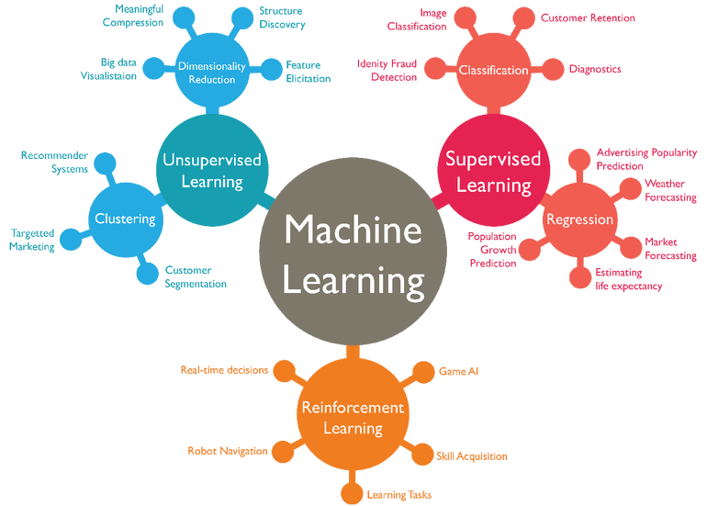
UN –INFORMATIVE
INFORMATIVE
EXPLORATIVE
Notes:
Also helpful to see it as a exam with an answer-key, with no answer-key and instant marking. Explorative or evaluative .
Instructive feedback tells you how to achieve your goal, while evaluative feedback tells you how well you achieved your goal.
One other way to think about it would be it is much like our evolutionary process: the environment rewards the agent for things that it gets right and penalizes it for things that it gets wrong.
Giraffe example , cat example , we can train a dog to do a series of events just with the help of few biscuits

Slide 6
INFORMATIVE

Slide 7
UN –INFORMATIVE

Slide 8
UN –INFORMATIVE

Slide 9
Elements of RL
State
Action
Policy
Reward
Value function
Model
_ _ _ _ _ _ _ _ _ _ _ _ _ _ _ _ _

Slide 10
Policy
ACTIONS
STATE
VALUE
FUNCTION
REWARD
value
MODEL
Notes:
Instead of providing the model with ‘correct’ actions. we provide it with rewards and punishments.
The model receives information about the current state of the environment (e.g. the computer game screen).
It then outputs an action, like a joystick movement.
The environment reacts to this action and provides the next state, alongside with any rewards.
The model then learns to find actions that lead to maximum rewards.
A policy defines the learning agent’s way of behaving at a given time. Roughly speaking, a policy is a mapping from perceived states of the envi-ronment to actions to be taken when in those states. It corresponds to what in psychology would be called a set of stimulus–response rules or associations
A reward signal defines the goal in a reinforcement learning problem. On each time step, the environment sends to the reinforcement learning agent a single number, a reward.
Whereas the reward signal indicates what is good in an immediate sense,a value function specifies what is good in the long run. Roughly speaking, the value of a state is the total amount of reward an agent can expect to accumulate over the future, starting from that state.
The fourth and final element of some reinforcement learning systems is a model of the environment. This is something that mimics the behavior of the environment, or more generally, that allows inferences to be made about how the environment will behave.

Slide 11
0
1
r
a
ACTIONS
0
π
Policy
s
STATE
0

Slide 12
a
S'
Policy
π
s
1
r
STATE

Slide 13
Q Learning
Q Table
Getting the Q table
Deep Q learning
Enhancements
_ _ _ _ _ _ _ _ _ _ _ _ _ _ _ _ _

Slide 14
Q Learning
Q-learning is a model-free reinforcement learning technique.
An Markov Decision Process is typically defined by a 4-tuple (S,A,R,T) where
S is the state/observation space of an environment
A is the set of actions the agent can choose between
R(s, a) is a function that returns the reward received for taking action a in state s
T(s′ | s, a) is a transition probability function, specifying the probability that the environment will transition to state s′ if the agent takes action a in state s.
Our goal is to find a policy π that maximizes the expected future (discounted) reward.
Notes:
What do I mean by a model free reinforcement learning technique. That means it does not have a model of its environment.
But what does having a model of your environment actually mean?
Lets do quick recap of Markov decision processes so that we can come back to it.
Markov decision processes (MDPs) provide a mathematical framework for modeling decision making in situations where outcomes are partly random and partly under the control of a decision maker.
Discounted, Why discounted ? Why not future reward ?
The catch is you don’t exactly know what the future reward is
used to model the fact that the decision maker is uncertain about if in the next decision instant the world.
It is also an trick to show that the algorithm converges, since this way you can bound infinite sums.
discount factor - A scalar value between 0 and 1 which determines the present value of future rewards.

Slide 15
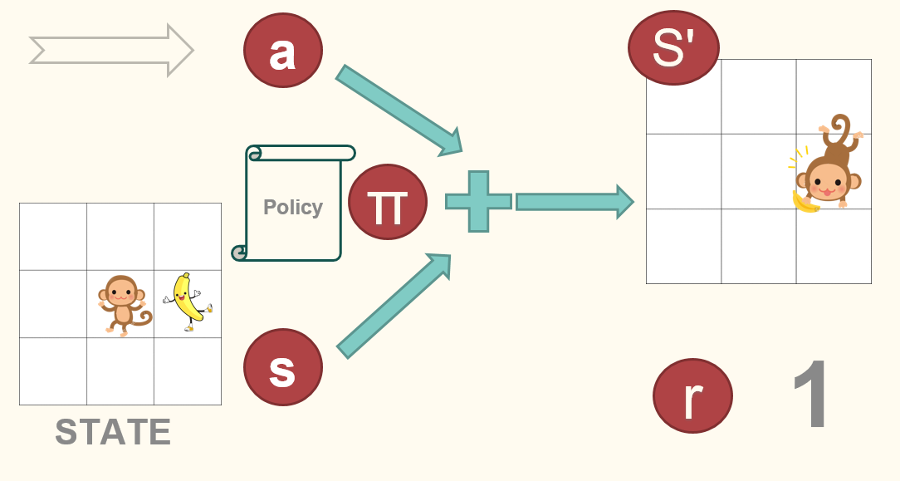
Q Learning
Q-learning is a model-free reinforcement learning technique.
Specifically, Q-learning can be used to find an optimal action-selection policy for any given (finite) Markov decision process (MDP)
It works by learning an action-value function, often denoted by Q(s,a)
When such an action-value function is learned, the optimal policy can be constructed by simply selecting the action with the highest value in each state
Notes:
What do I mean by a model free reinforcement learning technique. That means it does not have a model of its environment.
But what does having a model of your environment actually mean?
Lets do quick recap of Markov decision processes so that we can come back to it.
Markov decision processes (MDPs) provide a mathematical framework for modeling decision making in situations where outcomes are partly random and partly under the control of a decision maker.
Why finite , why not infinite? ,because there is a memory limit and games like go, chess baghchal can easily have 10 30, chess has 10 50 and go well it has around 10^170 possible game moves
Discounted, Why discounted ? Why not future reward ?
The catch is you don’t exactly know what the future reward is
used to model the fact that the decision maker is uncertain about if in the next decision instant the world.
It is also an trick to show that the algorithm converges, since this way you can bound infinite sums.

Slide 16
Q Learning Algorithm

Slide 17
Q Learning
State | LEFT | UP | Right | Down
101 | 0 | 0 | 0 | 0
102 | 0 | 0 | 0 | 0
103 | 0 | 0 | 0 | 0
… | … | … | … | …
Training / Explorations
State | LEFT | UP | Right | Down
101 | 0.1 | 0.1 | 0.1 | 0.1
102 | 0.2 | 0.95 | 0.2 | 0.2
103 | 0.2 | 0.2 | 0.95 | 0.2
… | … | … | … | …

Slide 18
Extensions: Deep Q Networks
Doesn’t scale well.
Deep learning is basically just a universal approximation machine which can understand and come up with abstract representations.
Deep learning can be used to approximate Q values, and it can also easily learn optimal Q values by using gradient descent.
Now it becomes Deep Q learning
Google has a patent on some elements of Deep Q learning BTW
Notes:
The problem with using Q learning with tables is that it doesn’t scale well.
Why finite , why not infinite? ,because there is a memory limit and games like go, chess baghchal can easily have 10 30, chess has 10 50 and go well it has around 10^170 possible game moves
"DQN incorporated several key features that for the first time enabled the power of Deep Neural Networks (DNN) to be combined in a scalable fashion with Reinforcement Learning (RL)—a machine learning framework that prescribes how agents should act in an environment in order to maximize future cumulative reward (e.g., a game score). Foremost among these was a neurobiologically inspired mechanism, termed “experience replay,” whereby during the learning phase DQN was trained on samples drawn from a pool of stored episodes—a process physically realized in a brain structure called the hippocampus through the ultra-fast reactivation of recent experiences during rest periods (e.g., sleep). Indeed, the incorporation of experience replay was critical to the success of DQN: disabling this function caused a severe deterioration in performance."

Slide 19
Further Notions
Exploration vs Exploitation
On Policy and Off Policy
Model Free and Model Based Algorithms
Monte Carlo methods
discount factor
TD (temporal difference) algorithms
_ _ _ _ _ _ _ _ _ _ _ _ _ _ _ _ _

Slide 20
Exploration vs Exploitation
Continuous control
Policy Gradient
Actor Critic Models
Value Networks
Experience Replay
Monte Carlo Methods
Hierarchial Learning
Prioritized Experience Replay
TD(λ) Algorithms
Notes:
By “the state" we generally mean whatever information is available to the agent.
Certainly the state signal should include immediate sensations such as sensory measurements, but it can contain much more than that.
Can be highly processed versions of original sensations, or they can be complex structures built up over time from the sequence of sensations.
The state signal should not be expected to inform the agent of everything about the environment , or even everything that would be useful to it in making decisions.
What we would like, ideally, is a state signal that summarizes past sensations compactly, yet in such a way that all relevant information is retained.
What we feed to the agent
Drone with wind reading and speed readings and gps and camera inputs
Obstacle present or not ? Is this the right path to the destination ?
Eye focusing in on things and making a model. Modelling a whole building i see i turn back it is still there
What is in your hand ? who is calling on the telephone?
This is sometimes also referred to as an \independence of path" property because all that matters is in the current state signal
sums and probabilities rather than integrals and probability densities
We always want the state to be a good basis for predicting future rewards and for selecting actions.
If it is a learned model of the environment we also want the state to be a good basis for predicting subsequent states.
Markov property is so good that we would like to model our environments as one even when they are not.
Pole balancing problem => position and velocity of the cart | angle between the cart and the pole | rate at which this angle is changing
In the real world its not possible, bending of pole, sensor delay, temp of bearing , track consistency

Slide 21
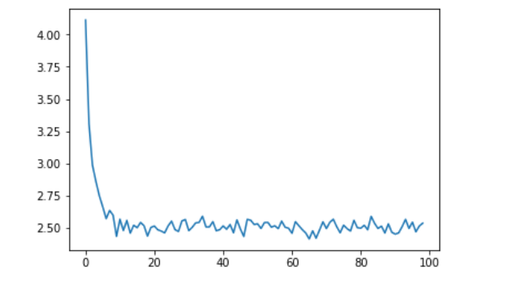
Q Learning – Monkey and Bananas

Slide 22
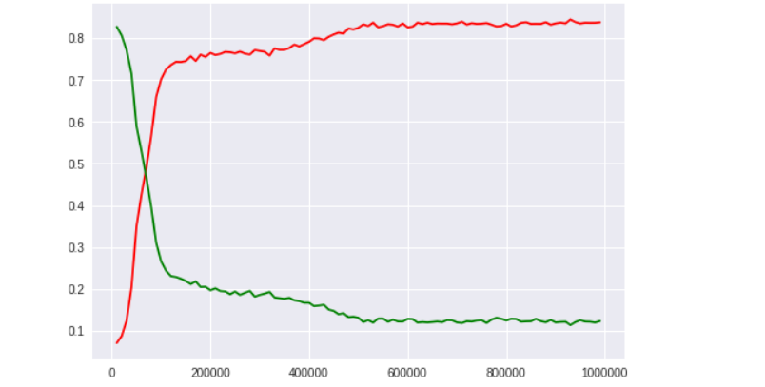
Policy Gradient – Tic Tac Toe

Slide 23
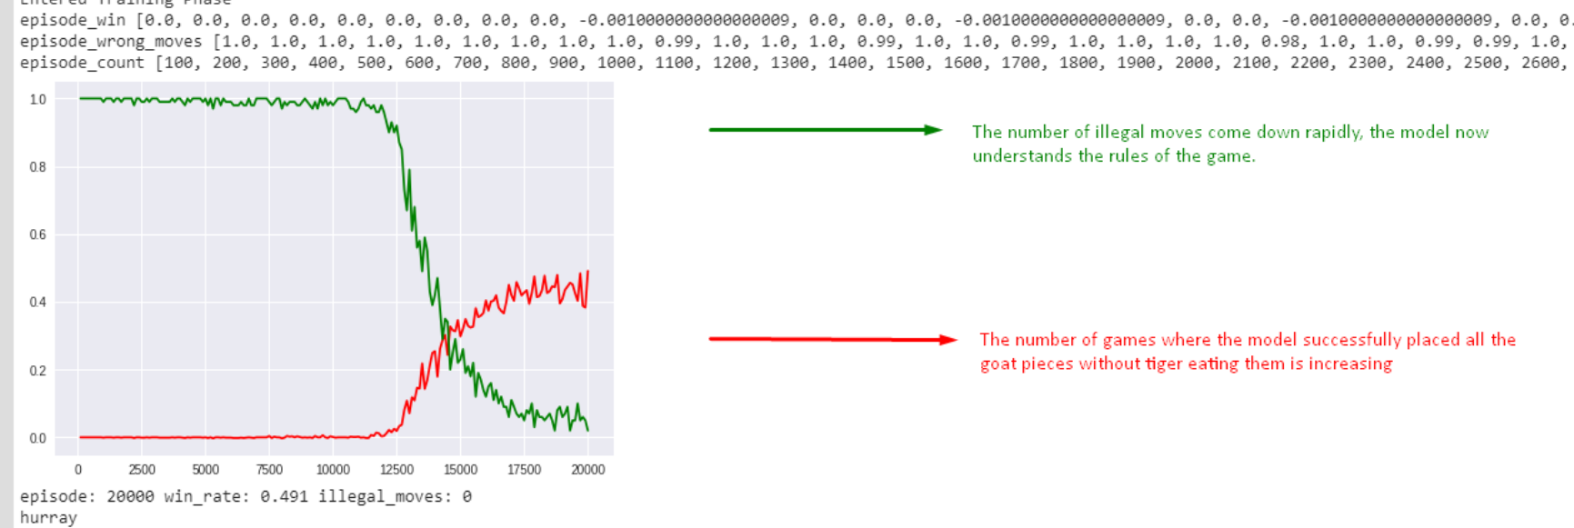
BaghChal

Slide 24
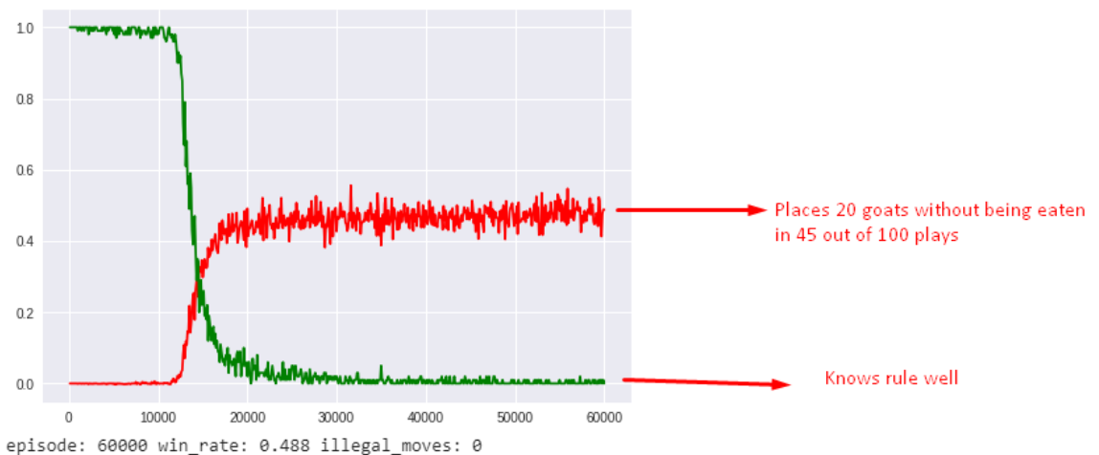
BaghChal

Slide 25
Where to Start
Basic Literature: https://joshgreaves.com/reinforcement-learning/introduction-to-reinforcement-learning/>
Q Learning. : http://people.revoledu.com/kardi/tutorial/ReinforcementLearning/
Deep Q learning. : https://ai.intel.com/demystifying-deep-reinforcement-learning/
Intermediate Literature.
455-page free book: Reinforcement Learning: An Introduction (2nd Edition) by Richard S. Sutton and Andrew G. Barto (2016)
David Silver's Reinforcement Learning Course
Policy Gradients, Actor-Critic Methods . . . .
Further Resources: https://github.com/aikorea/awesome-rl
If the state possesses Markov Property (One Step Dynamics)
The best policy for choosing actions as a function of a Markov state is just as good as the best policy for choosing actions as a function of complete histories
Notes:
This is sometimes also referred to as an \independence of path" property because all that matters is in the current state signal
sums and probabilities rather than integrals and probability densities
We always want the state to be a good basis for predicting future rewards and for selecting actions.
If it is a learned model of the environment we also want the state to be a good basis for predicting subsequent states.
Markov property is so good that we would like to model our environments as one even when they are not.
Pole balancing problem => position and velocity of the cart | angle between the cart and the pole | rate at which this angle is changing
In the real world its not possible, bending of pole, sensor delay, temp of bearing , track consistency
s

Slide 26
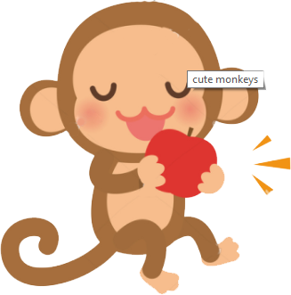
Thank You . . . .

