Slide 1
Developer Sessions
Works and Announcements

Slide 2
Kshitiz Rimal
AI/Deep Learning Enthusiast
Intel AI Student Ambassador
Web/Mobile Developer
UI/UX Designer

Slide 3
About Developer Sessions
Developers’ community
Focused on AI Education

Slide 4
Past Activities
Recently started working
One counselling session
One 2-day Workshop focused on Deep Learning

Slide 5
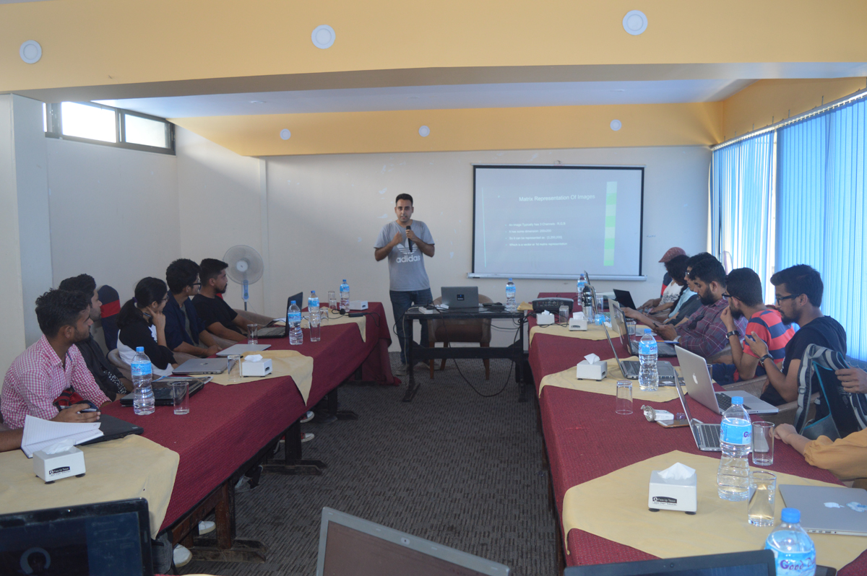
2 Day workshop on Deep Learning prerequisites

Slide 6
Vision
To provide Education on AI
To provide resources to facilitate learning process
Creating environment through gather, share and develop ideas
Connecting Education with Industry, by inspiring new breed of startups based on AI

Slide 7
Future Plans

Slide 8
Workshops
Just enough theory to get you started
Application based approach
2-3 days long
Starting from basic idea behind ML to creating and training deep neural networks. Which includes, Convolutional Neural Networks, RNN, Techniques such as Transfer Learning etc.

Slide 9
Workshops
Framework oriented
Access to tools and resources

Slide 10
DevMEsh Platform
devmesh.intel.com
Find and follow world-class developers, share your own projects, and collaborate with others.

Slide 12
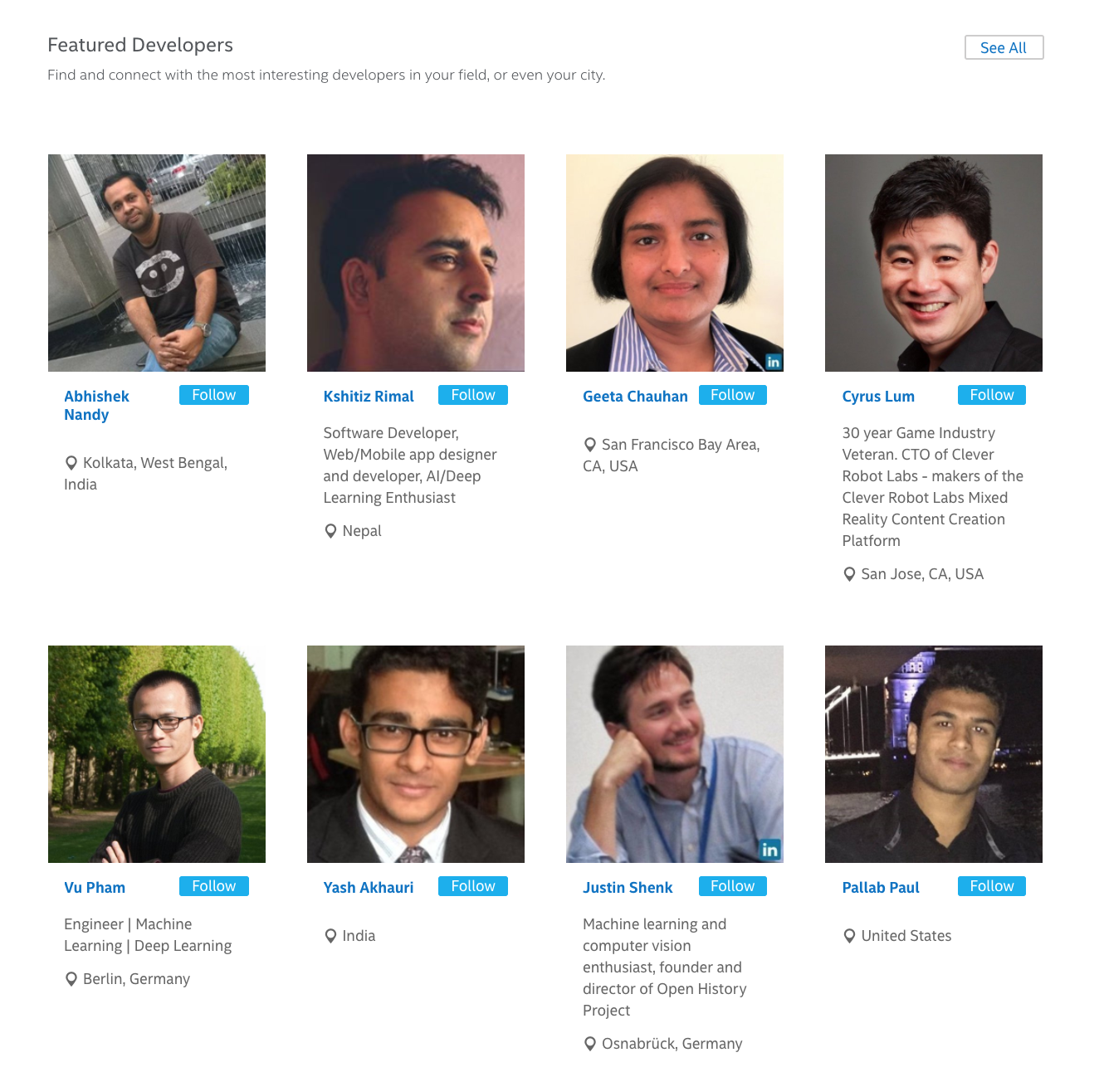

Slide 13
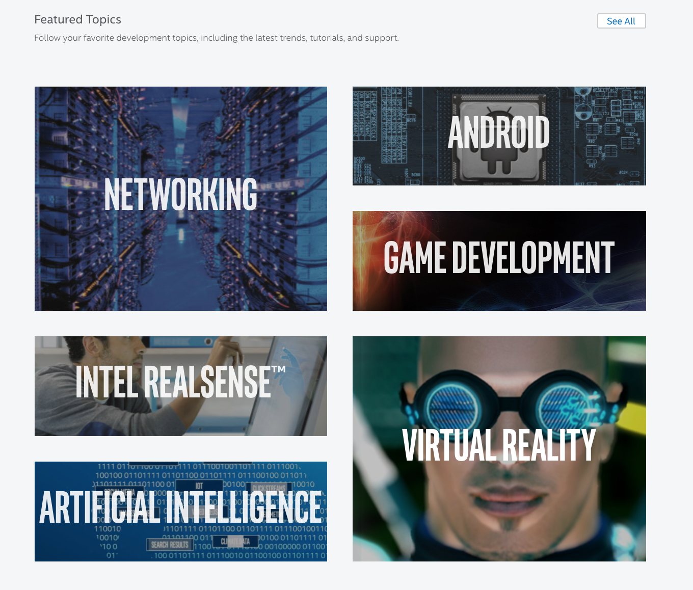

Slide 14
Training by Intel
software.intel.com

Slide 17
Resources by Intel
Intel AI Resources:
software.intel.com/en-us/ai-academy
Dev Mesh Platform:
devmesh.intel.com

Slide 18
Workshop
Workshop on Deep Learning: Feedforward Neural Network, CNN, RNNs, Transfer Learning, Style Transfer, recommender system, autoencoders etc
Training on Intel Xeon Phi Cluster:
Tensorflow*
Neon Framework
Keras*
Python*
And many other popular framework

Slide 19
Workshop
(Free access) Train and run models on AWS clouds supported for Deep Learning
(Free access) Qwiklab interactive labs and experiments

Slide 20
WORKSHOP
Developer Sessions recently got Deep Learning Teaching Kit from NVIDIA, which includes:
Detailed Course content on Deep Learning from New York University
Prepared by Yann LeCun, Director of AI Research at Facebook and Professor at NYU
Famous as Founding Father of Convolutional Neural Networks

Slide 21
Workshop
Starting from November
Stay connected for updates on facebook.com/groups/developersessions

Slide 22
On demand Workshops
For group of students of particular college
College/University consent is required
For professional employees
Consent of their organization is required
Custom Time Duration
Includes all the benefits of regular workshops

Slide 23
Helping individuals or Team on their project by teaching and providing resources
If you have a team and working on a machine learning related project for your college or your new startup idea and don’t have resources to learn, or test your ideas, let us know. We will help in any way we can.

Slide 24
Online Resources
Recommended Courses for Beginners:
Machine Learning Course by Andrew NG: Coursera Machine Learning
Deep Learning course by Andrew NG: deeplearning.ai
Fast.ai MOOC courses: course.fast.ai
CS231n: Convolutional Neural Networks for Visual Recognition

Slide 26
Deep Learning Journal
medium.com/deep-learning-journals

Slide 28
medium.com/deep-learning-journals/how-i-am-learning-deep-learning-3d804bb31704

Slide 30
My DEV MESH Profile
devmesh.intel.com/users/kshitiz-rimal

Slide 31
Developer Sessions Github Account
github.com/devSessions

Slide 33
Q&A

Slide 34
Thank you

